Slide 1
Progress, Computer Science Education, and the Blockchain
Franklin Bueno

Slide 2
Introduction
Big Question
Learning Resources
Special Topic - Blockchain
Special Request...

Slide 3
I Big Question

Slide 4
Big Question
How Awesome Would It Be for Us to Reconvene This Time Next Year (December 2020) and Share Our Great Progress Together in Computer Science?

Slide 5
Ancillary Questions
How would one go about studying computer science?
In what ways would one have to change in order to make big gains in computer science?
Together, let’s make our shared computer science endeavor special. Let’s make our journey special and something that brings the best of us. What makes most endeavors fizzle and burn out?

Slide 6
II Learning Resources

Slide 7
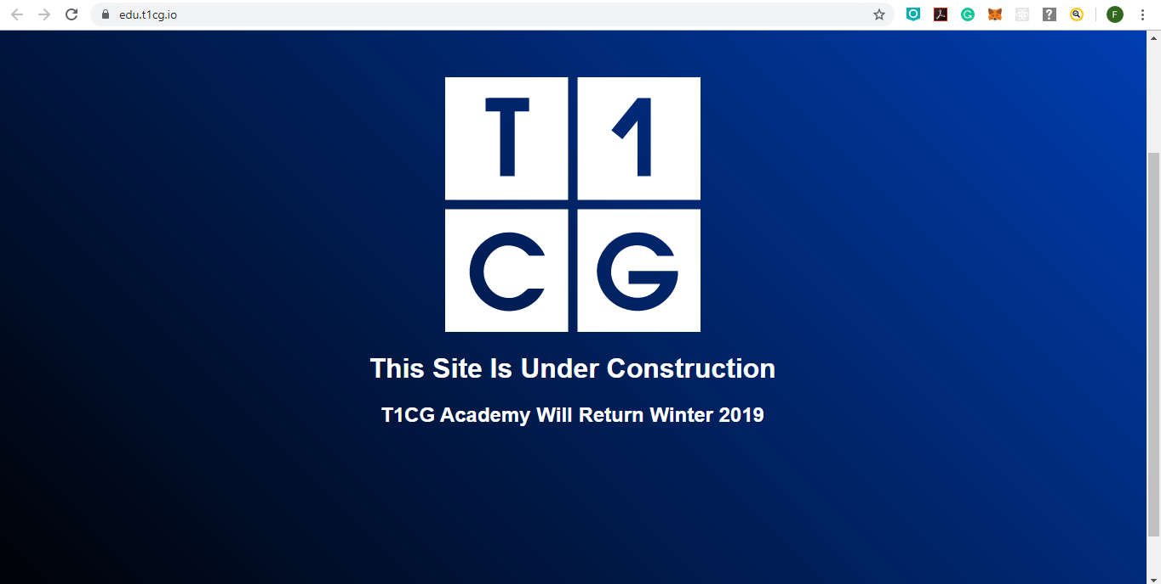
+++T1CG ACADEMY+++

Slide 8
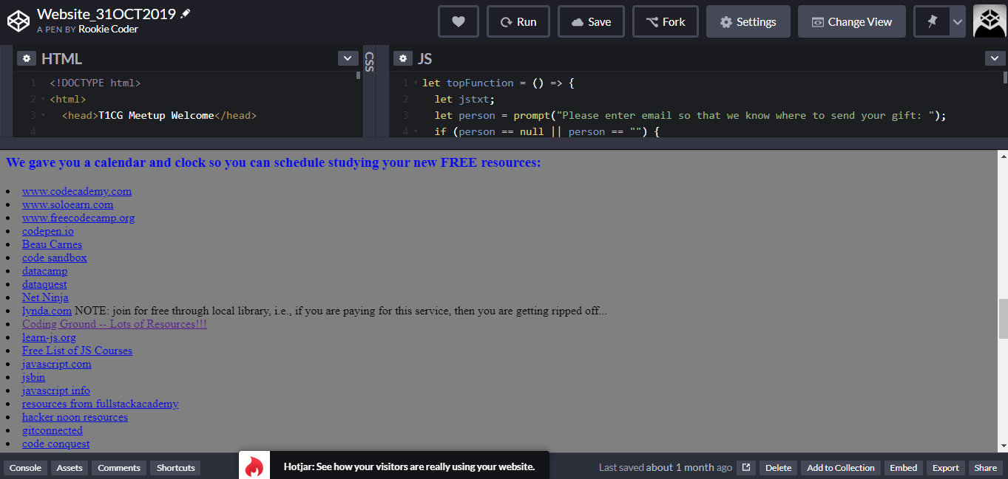

Slide 9
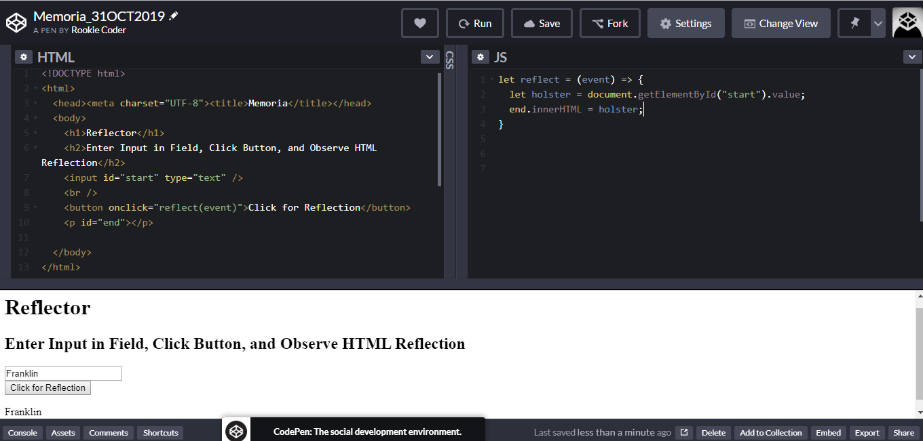
Daily Drills

Slide 10
Habits, Behaviors, and Approaches to Avoid
Rigidity
Summary of Rule from US Marine Corps - “You Have to Give Expectations, But You Cannot Tell How to Meet Aforementioned Expectations”
Going through the Motions/Rote Learning
Makes the Mind Lazy
Destroys the Fun of Learning
Discouragement/Loss of Vision
“You Make Your Limitations”

Slide 11
III Special Topic - Blockchain

Slide 12
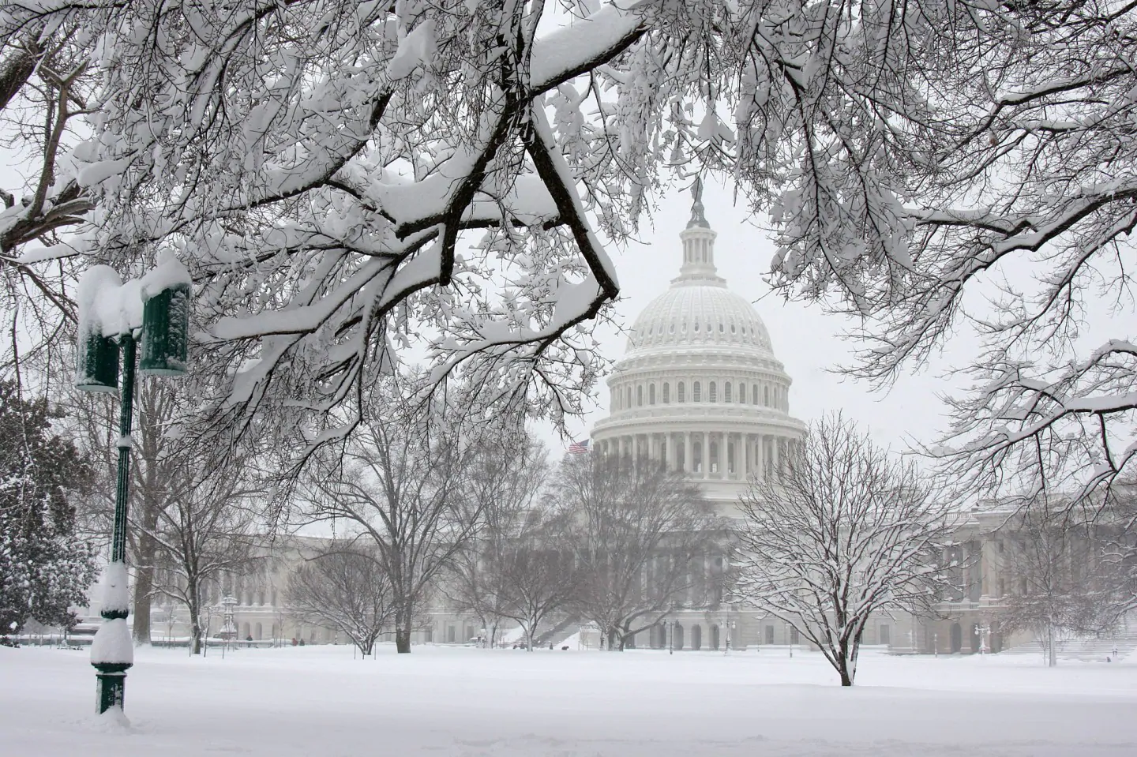
Late March, 2018
Prince George’s County, MD Electricity Outage for Multiple Days
Listened to Siraj Raval (https://www.youtube.com/channel/UCWN3xxRkmTPmbKwht9FuE5A) Anxiously

Slide 13


Great Escape 2018
California Road Trip from Santa Monica, Los Angeles (left) to UCSB Campus (right) and Back
Listened to Sentdex (https://www.youtube.com/user/sentdex) Summary of Bitcoin Paper the Whole Trip

Slide 14
Blockchain Terms
Blockchain
Distributed System
Ledger

Slide 15
Blockchain Term
Blockchain (1/3)
The block is a structure of information, with, in general, three components.
Data (e.g., statement that “Bank of Tokyo is wiring to Franklin Bueno five million (5.0 * 10^6) USD on December 12, 2019 1620 EST.”)
Hash, Digital Fingerprint That Changes with Data Change
Hash of Previous Block (in genesis (initial) block, there is a specific alternate hash)
The repetition of the hash of a block between a block and its previous block forms a link in the blockchain.
The chain is the stack of blocks as connected by the hash components.
Changing the data component in a block changes the hash component.
Proof of work serves as another control - this is the verification process (through the solution of a puzzle) for the addition of a block.
The mutability of the hash values and the stacking of blocks form a structured sequence; this structured sequence is supposed to form a secure certificate.
https://www.youtube.com/watch?v=SSo_EIwHSd4

Slide 16
Blockchain Term
Distributed System (2/3)
Two (2) layers of protection were given in the previous slide.
Hash Certification
Proof of Work
Opening the construction of the blockchain to inspection by the public (with each member serving as a node in a distributed system) provides another layer of protection; 51% of the nodes have to validate the block.
At each node, the blockchain for the data is being certified simultaneously and in coordination with the other certified nodes.
The reward for this inspection is cryptocurrency.

Slide 17
Blockchain Term
Ledger (3/3)
Structure and Process of Verification Form a Ledger
Ledger Further Checked by Distributed System
At Least One Vulnerability - 51% Attack

Slide 18
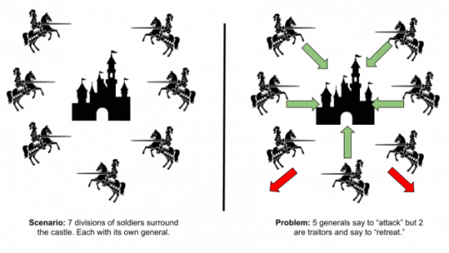
Blockchain Application
Solution to Byzantine Siege Problem
https://medium.com/nakamo-to/the-byzantine-generals-problem-1ae994eaba7e

Slide 19
Blockchain Terms
Summary
One may substitute the term “blockchain” for “a series of individualized data structures, or blocks of data, arranged in a specific sequence, or chain.” A distributed system serves to certify each data structure by having independent nodes validate each block in the chain. This certification process is supposed to supersede challenges and weaknesses in modern ledger technology; a blockchain is supposed to be the best ledger on Earth.

Slide 20

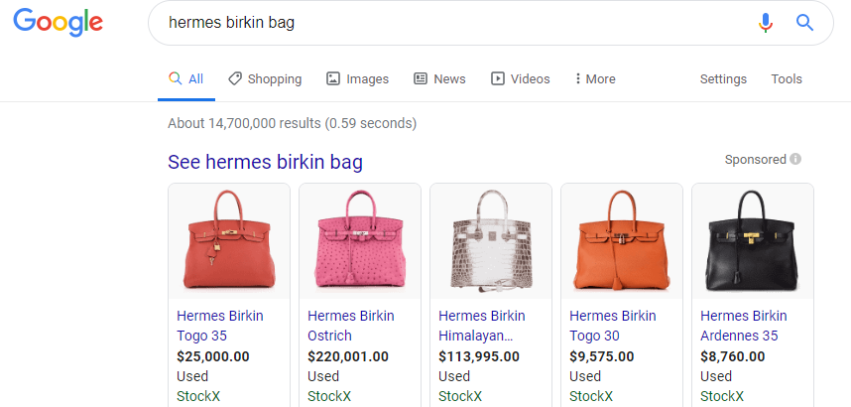
Blockchain - Next Episode
Blockchain Applications

Slide 21
Thank You
More Sources Coming Soon.

